Slide 1

Project Quality Management

Slide 2
Session objectives
Explain quality and project quality management
Explain project quality management processes
Describe tools and techniques
Explain types of project quality costs

Slide 3
What is Quality?
The International Organization for Standardization (ISO) defines quality as the totality of characteristics of an entity that bear/allow on its ability to satisfy stated or implied needs.
Other experts define quality based on
  Conformance to requirements: meeting written specifications/task completeness.
  Fitness for use: ensuring a product can be used as it was intended/proposed.

Slide 4
Project Quality Management
It includes the processes for incorporating the organization’s quality policy regarding:
  Planning, managing, and
  Controlling project/product quality requirements in order to meet stakeholders objectives.

Slide 5
Modern Quality Management
Modern quality management
  Requires customer satisfaction
  Prefers prevention to inspection
  Recognizes management responsibility for quality.

Slide 6
Project Quality Management Processes
Quality planning: identifying which quality standards are relevant to the project and how to satisfy them.
Quality assurance: evaluating overall project performance to ensure the project will satisfy the relevant quality standards.
Quality control: monitoring /checking specific project results to ensure that they obey with the relevant quality standards although identifying ways to improve overall quality.

Slide 7
Quality Planning
The process of identifying which quality standards are relevant to the project and how to satisfy them.
It is important to design quality and important factors that directly contribute to meeting customer’s requirements.
Many aspects of software projects affect quality like functionality, features, system outputs, performance, reliability, and maintainability…..

Slide 8
Quality Assurance
Quality assurance is the process, that includes all the activities related to satisfying the relevant quality standards for a project.
or a process of translating quality mang plan in to executable quality activities that incorporate the organizations quality policies in to project.
The goal of quality assurance is continuous quality improvement.

Slide 9
Quality Control
The process of monitoring and recording specific project results to ensure that,
  They obey with the relevant quality standards
  The project outputs are complete ,correct and meet customer expectation.
The main outputs of quality control are
  acceptance decisions, rework , process adjustments…..
Some tools and techniques include
  pareto analysis
  statistical sampling
  quality control charts
  testing

Slide 10
Pareto Analysis
Pareto analysis involves identifying the vital few contributors that account for the most quality problems in a system
Also called the 80-20 rule, meaning that 80% of problems are often due to 20% of the causes.
Pareto diagrams are histograms that help to identify and prioritize problem areas.

Slide 11
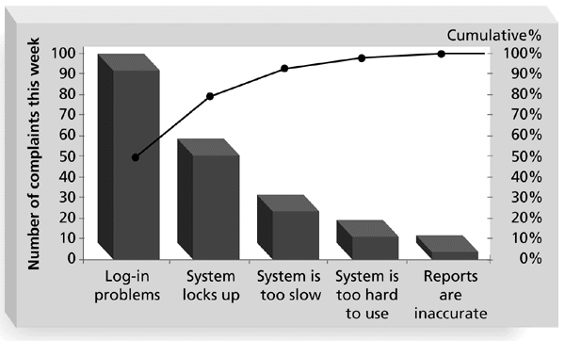
Sample Pareto Diagram

Slide 12
Statistical Sampling and Quality control charts
  Reading assignment………

Slide 13
Testing
Many SW professionals think testing as a stage that comes near the end of SW product development.
Testing should be done during almost every phase of the SDLC.
Can be manual or automated.

Slide 14
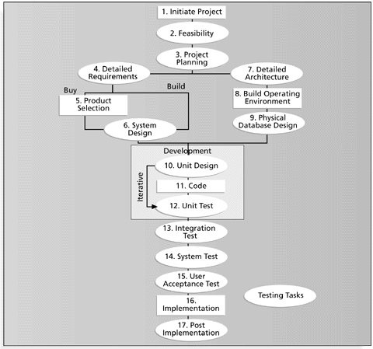
Testing tasks in the software development life cycle

Slide 15
Types of Tests
A unit test is done to test each individual component (often a program) to ensure it is as defect free as possible
Integration testing occurs between unit and system testing to test functionally grouped components.
System testing tests the entire system as one entity.
User acceptance testing is an independent test performed by the end user prior to accepting the delivered system.

Slide 16
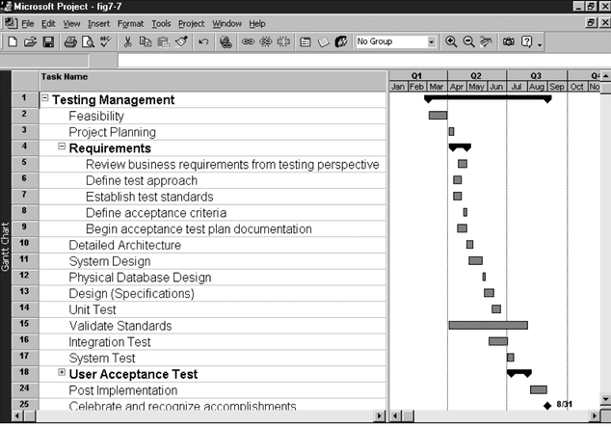
Gantt Chart for Building Testing into a Systems Development Project Plan

Slide 17
Improving Software Project Quality
A large percentage of quality problems are associated with management, not technical issues.
Several suggestions for improving quality for software projects include:
  Leadership that promotes quality
  Understanding the cost of quality.
  Focusing on organizational influences and workplace factors that affect quality
  Following maturity models to improve quality

Slide 18
Cost of Quality
The cost of quality is
  the cost of conformance or delivering products that meet requirements and fitness for use.
  the cost of nonconformance or taking responsibility for failures or not meeting quality expectations.

Slide 19
Cost Categories Related to Quality
The Cost of Quality category codes are the following:
  Prevention Costs
  Appraisal Costs
  Internal Error Costs
  External Error Costs
  Measurement and test equipment costs:

Slide 20
Prevention Costs
Prevention costs are investments made ahead of time in an effort to ensure conformance to requirements.
  Examples include activities such as orientation of team members, training, and the development of project standards and procedures.

Slide 21
Appraisal Costs
Appraisal costs are costs incurred to identify defects after the fact (real world).
  Examples include activities such as walkthroughs and testing.

Slide 22
Internal Error Costs
Internal error costs are the costs of rework and repair before delivery to a customer.
  An example is fixing faults detected during internal testing.

Slide 23
External Error Costs
External error costs are the costs of rework and repair after delivery to a customer.
  One example would be rework and repair resulting from acceptance testing.
  Another example would be the actual costs incurred during warranty support/ license.

Slide 24
Measurement and test equipment costs:
Measurement and test equipment costs: capital cost of equipment used to perform prevention and appraisal activities.

Slide 25
ISO 9000
An international set of standards for quality management.
Applicable to a range of organizations from manufacturing to service industries.
ISO 9001 applicable to organizations which design, develop and maintain products.
ISO 9001 is a generic model of the quality process that must be instantiated for each organization using the standard.

Slide 26
Software quality attributes

Slide 27
Thanks

